Slide 1


Data Analysis and Visualization CSE2015
VI – Semester (2022-2023)
Department of Computer Science Engineering
School of CSE & IS

Slide 2
Introduction

Slide 3
Outline
Course Overview
Do’s and Don'ts
Google Colab

Slide 4
Course Overview
Introduction to turning data into presentable graphics.
Data visualization techniques help people to better understand data.
The goal is to understand
data visualizations principles, techniques and algorithms for creating effective visualizations based on principles from graphic design, visual art, perceptual psychology, and cognitive science.
Students will learn the
value of visualization,
specific techniques in data visualization,
grammar of graphics and
how to leverage visualization tools.
Prerequisite
Data Structures, Statistics, Database Concepts, Python, Machine Learning and Creative Thinking

Slide 5
Syllabus Overview
Labsheet -1 [ 4 Practical Sessions] Working with Numpy Functions and Pandas functions Acquiring and plotting data. Labsheet -2 [ 4 Practical Sessions] Practicals based on Data Cleaning and Preparation Practicals based on Data Wrangling Statistical Analysis – such as Multivariate Analysis, PCA, LDA, Correlation regression and analysis of variance Labsheet – 3 [ 4 Practical Sessions] Practicals based on Data Visualization using matplotlib Visualization of various massive dataset - Finance - Healthcare - Census Labsheet – 4 [ 4 Practical Sessions] Practical based on Time Series Data Analysis-stock market Market-Basket Data analysis-visualization Text visualization using web analytics Labsheet -5 [ 4 Practical Sessions] Financial analysis using Clustering, Histogram and HeatMap Visualization on Streaming dataset (Stock market dataset, weather forecasting)

Slide 6
Guidelines
Preparatory works for lab sessions are mandatory.
Practice more exercises as self- study.
Students can use Anaconda(Offline)/Google Colab for executing the lab programs.
Students need to register for the online course and get cerification.(The course title will be informed by the instructor).
On successful completion of this course, they earn a 5%weightage (10 marks).
Students should write the program and output in record notebook and duly get signature from the course instructor with in a week.

Slide 7
Lab Exercises
Faculty will explain the concept with examples.
Students have to learn the concepts and implement the given exercises.
Faculty will evaluate the students every week and assign marks based on the below split-up
Execution | Viva | Total Marks
5 | 5 | 10

Slide 8
Do’s
Be punctual, log in on time
Read the syllabus
Respect your peers
Set up your space, make sure it’s quiet and uninterrupted
Embrace being flexible
Press “Raise your hands” button and wait to ask questions.

Slide 9
Don’ts
Don’t be a wallflower, don't be afraid to speak up
No excuses for bad tech
Ignore additional online resources /Gadgets
Don’t think you’re doing it all alone
Don’t get discouraged
Don’t distract the class

Slide 10
Do few stretching exercises (every 30 mins)

Slide 11
To do for Lab Sessions
Follow the instructor instructions properly.
Install Anaconda to work offline (Optional).
Login to Google Colab using your personal Gmail account @ colab.research.google.com and start coding.
Colab Notebook will be saved to your Google Drive.
After completing the assigned tasks of the particular week, upload the Colab Notebook in Teams.
10 Marks Per labsheet assigned tasks.

Slide 12
Tutorials on Google Colab
Introduction to Colab and Python
shorturl.at/coqvT
Google Colab Tutorial:
https://www.tutorialspoint.com/google_colab/index.htm
Getting Started With Google Colab:
https://towardsdatascience.com/getting-started-with-google-colab-f2fff97f594c
Get Started with Google Colab for Machine Learning and Deep Learning
https://www.analyticsvidhya.com/blog/2020/03/google-colab-machine-learning-deep-learning/

Slide 13
What is Google Colab?
If you have used Jupyter notebook previously, you would quickly learn to use Google Colab.
Colab is a free Jupyter notebook environment that runs entirely in the cloud.
It does not require a setup and the notebooks that you create can be simultaneously edited by your team members
just the way you edit documents in Google Docs.
Colab supports many popular machine learning libraries which can be easily loaded in your notebook.

Slide 14
What Colab Offers You?
As a programmer, you can perform the following using Google Colab.
Write and execute code in Python
Document your code that supports mathematical equations
Create/Upload/Share notebooks
Import/Save notebooks from/to Google Drive
Import/Publish notebooks from GitHub
Import external datasets e.g. from Kaggle
Integrate PyTorch, TensorFlow, Keras, OpenCV
Free Cloud service with free GPU

Slide 15
Your First Colab Notebook
Step 1
Open the following URL in your browser − https://colab.research.google.com
Your browser would display the following screen.
As Colab implicitly uses Google Drive for storing your notebooks, ensure that you are logged in to your Google Drive account before proceeding further.

Slide 16
Your First Colab Notebook

Slide 17
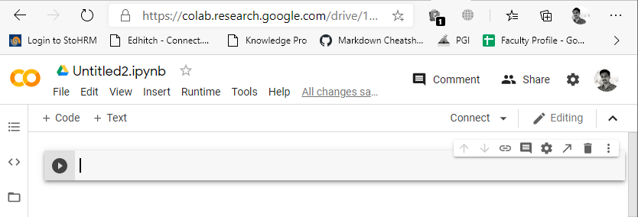
Your First Colab Notebook
Step 2
A new notebook would open up as shown in the screen below.
The notebook interface is quite similar to the one provided in Jupyter.
There is a code window in which you would enter your Python code.

Slide 18
Your First Colab Notebook
Setting Notebook Name
By default, the notebook uses the naming convention UntitledXX.ipynb.
To rename the notebook, click on this name and type in the desired name in the edit box as shown here −
We will call this notebook as MyFirstColabNotebook. So type in this name in the edit box and hit ENTER.
The notebook will acquire the name that you have given now.

Slide 19
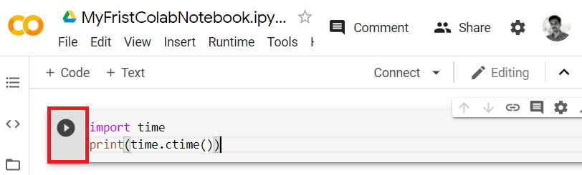
Your First Colab Notebook
Entering Code
You will now enter a trivial Python code in the code window and execute it.
Enter the following two Python statements in the code window −
import time
print(time.ctime())

Slide 20
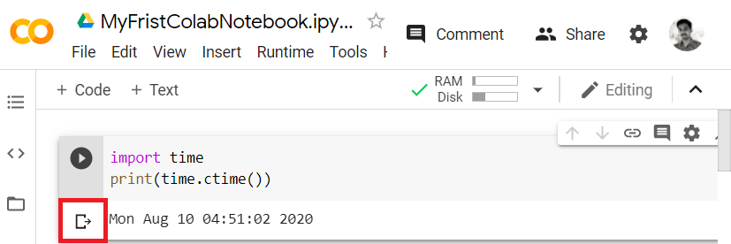
Your First Colab Notebook
Executing Code
To execute the code, click on the arrow on the left side of the code window.
After a while, you will see the output underneath the code window, as shown here −
You can clear the output anytime by clicking the icon on the left side of the output display.

Slide 21
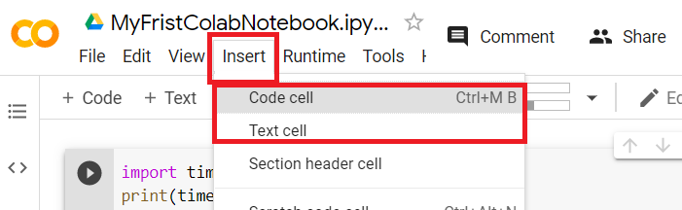
Your First Colab Notebook
Adding Code Cells
To add more code to your notebook, select the following menu options : Insert– >Code cell

Slide 22
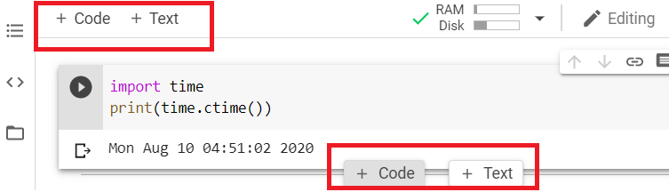
Your First Colab Notebook
Adding Code Cells
Alternatively, just hover the mouse at the bottom center of the Code cell.
When the CODE and TEXT buttons appear, click on the CODE to add a new cell.

Slide 23
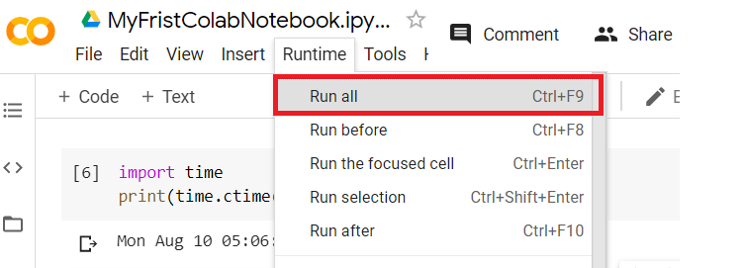
Your First Colab Notebook
Run All
To run the entire code in your notebook without an interruption, execute the following menu options −
Runtime -> Run all…

Slide 24
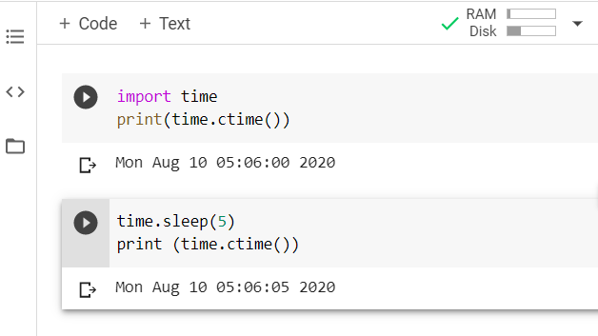
Your First Colab Notebook
Run All
It will give you the output as shown below −
Study the different menu options under the Runtime menu to get yourself acquainted with the various options available to you for executing the notebook.

Slide 25
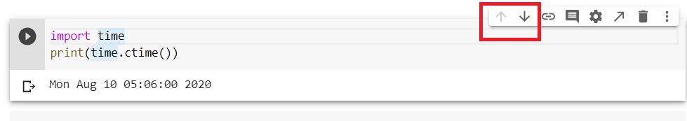
Your First Colab Notebook
Changing Cell Order
When your notebook contains a large number of code cells, you may come across situations where you would like to change the order of execution of these cells.
You can do so by selecting the cell that you want to move and clicking the UP CELL or DOWN CELL buttons shown in the following screenshot −
You may click the buttons multiple times to move the cell for more than a single position.

Slide 26
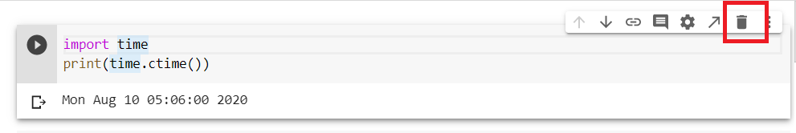
Your First Colab Notebook
Deleting Cell
During the development of your project, you may have introduced a few now-unwanted cells in your notebook.
You can remove such cells from your project easily with a single click.
Click on the delete icon at the top right corner of your code cell.
Click on the Delete cell option and the current cell will be deleted.

Slide 27
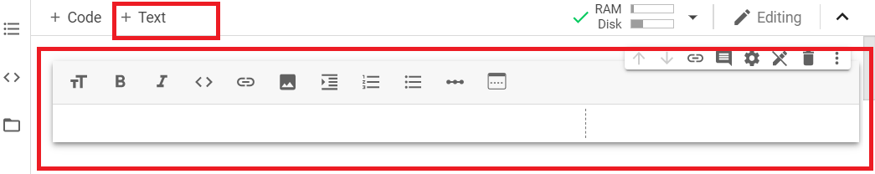
Documenting Your Code
As the code cell supports full Python syntax, you may use Python comments in the code window to describe your code.
However, many a time you need more than a simple text based comments to illustrate the ML algorithms.
ML heavily uses mathematics and to explain those terms and equations to your readers you need an editor that supports LaTex - a language for mathematical representations.
Colab provides Text Cells for this purpose.
Text Cells are formatted using markdown - a simple markup language.
Let us now see you how to add text cells to your notebook.

Slide 28

Documenting Your Code
Markdown Examples
Let us look into few examples of markup language syntax to demonstrate its capabilities.
Type in the following text in the Text cell.
This is **bold**.
This is *italic*.
This is ~strikethrough~.
The output of the above commands is rendered on the right hand side of the Cell as shown here.

Slide 29


Documenting Your Code
Mathematical Equations
Add a Text Cell to your notebook and enter the following markdown syntax in the text window −
$\sqrt{3x-1}+(1+x)^2$
You will see the immediate rendering of the markdown code in the right hand side panel of the text cell.
Hit Enter and the markdown code disappears from the text cell and only the rendered output is shown.

Slide 30
Documenting Your Code
You can find more details on Markdown in the Markdown Cheat sheet and links are given below
https://github.com/adam-p/markdown-here/wiki/Markdown-Cheatsheet
https://daringfireball.net/projects/markdown/syntax
https://about.gitlab.com/handbook/markdown-guide/
https://markdown-guide.readthedocs.io/en/latest/
https://en.wikipedia.org/wiki/Markdown

Slide 31
Saving Your Work
Colab allows you to save your work to Google Drive or even directly to your GitHub repository.
Saving to Google Drive
Colab allows you to save your work to your Google Drive.
To save your notebook, select the following menu options − File -> Save a copy in Drive…
Saving to GitHub
You may also save your work to your GitHub repository by selecting the following menu options −File -> Save a copy in GitHub...
You will have to wait until you see the login screen to GitHub.
Now, enter your credentials. If you do not have a repository, create a new one and save your project.

Slide 32
Sharing Notebook
To share the notebook that you have created with other co-developers, you may share the copy that you have made in your Google Drive.
To publish the notebook to general audience, you may share it from your GitHub repository.
There is one more way to share your work and that is by clicking on the SHARE link at the top right hand corner of your Colab notebook.
You may enter the email IDs of people with whom you would like to share the current document.
You can set the kind of access by selecting from the options shown in the above screen.

Slide 33
Your First Visualization Program
import numpy as np
from matplotlib import pyplot as plt
y = np.random.randn(100)
x = [x for x in range(len(y))]
plt.plot(x, y)
plt.title("Sample Plot")
plt.show()

Slide 34
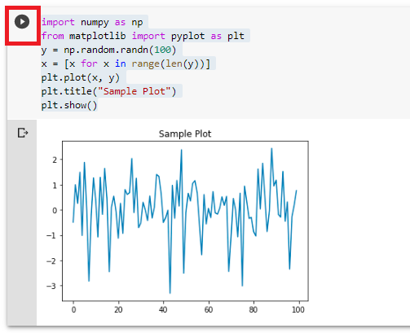
Your First Visualization Program

Slide 35
NumPy
NumPy is a Python package. It stands for 'Numerical Python'. It is a library consisting of multidimensional array objects and a collection of routines for processing of array.
Numeric, the ancestor of NumPy, was developed by Jim Hugunin. Another package Numarray was also developed, having some additional functionalities. In 2005, Travis Oliphant created NumPy package by incorporating the features of Numarray into Numeric package. There are many contributors to this open source project.

Slide 36
Operations using NumPy
Using NumPy, a developer can perform the following operations −
Mathematical and logical operations on arrays.
Fourier transforms and routines for shape manipulation.
Operations related to linear algebra.
NumPy has in-built functions for linear algebra and random number generation.

Slide 37
NumPy – A Replacement for MatLab
NumPy is often used along with packages like SciPy (Scientific Python) and Mat−plotlib (plotting library).
This combination is widely used as a replacement for MatLab, a popular platform for technical computing.
However, Python alternative to MatLab is now seen as a more modern and complete programming language.
It is open source, which is an added advantage of NumPy.

Slide 38
NumPy package is imported using the following syntax −
import numpy as np

Slide 39
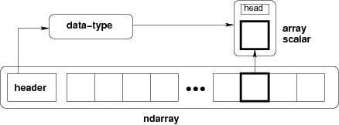
The most important object defined in NumPy is an N-dimensional array type called ndarray. It describes the collection of items of the same type. Items in the collection can be accessed using a zero-based index.
Every item in an ndarray takes the same size of block in the memory. Each element in ndarray is an object of data-type object (called dtype).
Any item extracted from ndarray object (by slicing) is represented by a Python object of one of array scalar types.
The following diagram shows a relationship between ndarray, data type object (dtype) and array scalar type −

Slide 40
An instance of ndarray class can be constructed by different array creation routines described later in the tutorial. The basic ndarray is created using an array function in NumPy as follows −
numpy.array
It creates an ndarray from any object exposing array interface, or from any method that returns an array.

Slide 41
numpy.array(object, dtype = None, copy = True, order = None, subok = False, ndmin = 0)
The above constructor takes the following parameters −
Sr.No. | Parameter & Description
1 | object Any object exposing the array interface method returns an array, or any (nested) sequence.
2 | dtype Desired data type of array, optional
3 | copy Optional. By default (true), the object is copied
4 | order C (row major) or F (column major) or A (any) (default)
5 | subok By default, returned array forced to be a base class array. If true, sub-classes passed through
6 | ndmin Specifies minimum dimensions of resultant array

Slide 42
Example:
import numpy as np
a = np.array([1,2,3])
print a
# more than one dimensions
import numpy as np
a = np.array([[1, 2], [3, 4]])
print a

Slide 43
Example:
# minimum dimensions
import numpy as np
a = np.array([1, 2, 3,4,5], ndmin = 2)
print a
# dtype parameter
import numpy as np
a = np.array([1, 2, 3],
dtype = complex)
print a

Slide 44
NumPy - Array Attributes
ndarray.shape:
This array attribute returns a tuple consisting of array dimensions. It can also be used to resize the array.
import numpy as np
a = np.array([[1,2,3],[4,5,6]])
print a.shape
# this resizes the ndarray
mport numpy as np
a = np.array([[1,2,3],[4,5,6]])
a.shape = (3,2)
print a

Slide 45
NumPy - Array Attributes
import numpy as np
a = np.array([[1,2,3],[4,5,6]])
b = a.reshape(3,2)
print b
ndarray.ndim:
This array attribute returns the number of array dimensions.
# an array of evenly spaced numbers
import numpy as np
a = np.arange(24)
print a

Slide 46
NumPy - Array Attributes
# this is one dimensional array
import numpy as np
a = np.arange(24) a.ndim
# now reshape it
b = a.reshape(2,4,3)
print b
# b is having three dimensions
numpy.itemsize:
This array attribute returns the length of each element of array in bytes.

Slide 47
NumPy - Array Attributes
numpy.itemsize:
This array attribute returns the length of each element of array in bytes.
# dtype of array is int8 (1 byte)
import numpy as np
x = np.array([1,2,3,4,5], dtype = np.int8)
print x.itemsize
# dtype of array is now float32 (4 bytes)
import numpy as np
x = np.array([1,2,3,4,5], dtype = np.float32)
print x.itemsize

Slide 48
NumPy - Array Attributes
numpy.flags:
The ndarray object has the following attributes. Its current values are returned by this function.
Sr.No. | Attribute & Description
1 | C_CONTIGUOUS (C) The data is in a single, C-style contiguous segment
2 | F_CONTIGUOUS (F) The data is in a single, Fortran-style contiguous segment
3 | OWNDATA (O) The array owns the memory it uses or borrows it from another object
4 | WRITEABLE (W) The data area can be written to. Setting this to False locks the data, making it read-only
5 | ALIGNED (A) The data and all elements are aligned appropriately for the hardware
6 | UPDATEIFCOPY (U) This array is a copy of some other array. When this array is deallocated, the base array will be updated with the contents of this array

Slide 49
NumPy - Array Attributes
import numpy as np
x = np.array([1,2,3,4,5])
print x.flags

Slide 50
NumPy - Array Creation Routines
A new ndarray object can be constructed by any of the following array creation routines or using a low-level ndarray constructor.
numpy.empty:
It creates an uninitialized array of specified shape and dtype. It uses the following constructor −
numpy.empty(shape, dtype = float, order = 'C')
Sr.No. | Parameter & Description
1 | Shape: Shape of an empty array in int or tuple of int
2 | Dtype: Desired output data type. Optional
3 | Order: 'C' for C-style row-major array, 'F' for FORTRAN style column-major array

Slide 51
NumPy - Array Creation Routines
A new ndarray object can be constructed by any of the following array creation routines or using a low-level ndarray constructor.
numpy.empty:
It creates an uninitialized array of specified shape and dtype. It uses the following constructor −
numpy.empty(shape, dtype = float, order = 'C')
Sr.No. | Parameter & Description
1 | Shape: Shape of an empty array in int or tuple of int
2 | Dtype: Desired output data type. Optional
3 | Order: 'C' for C-style row-major array, 'F' for FORTRAN style column-major array

Slide 52
NumPy - Array Creation Routines
import numpy as np
x = np.empty([3,2], dtype = int)
print x
numpy.zeros:
Returns a new array of specified size, filled with zeros.
numpy.zeros(shape, dtype = float, order = 'C')
Sr.No. | Parameter & Description
1 | Shape: Shape of an empty array in int or sequence of int
2 | Dtype: Desired output data type. Optional
3 | Order: 'C' for C-style row-major array, 'F' for FORTRAN style column-major array

Slide 53
NumPy - Array Creation Routines
# array of five zeros. Default dtype is float
import numpy as np
x = np.zeros(5)
print x
import numpy as np
x = np.zeros((5,), dtype = np.int)
print x
# custom type
import numpy as np x = np.zeros((2,2), dtype = [('x', 'i4'), ('y', 'i4')])
print x
numpy.ones:
Returns a new array of specified size and type, filled with ones.
numpy.ones(shape, dtype = None, order = 'C')

Slide 54
NumPy - Array From Existing Data
numpy.as array:
This function is similar to numpy.array except for the fact that it has fewer parameters. This routine is useful for converting Python sequence into ndarray.
numpy.asarray(a, dtype = None, order = None)
Sr.No. | Parameter & Description
1 | a Input data in any form such as list, list of tuples, tuples, tuple of tuples or tuple of lists
2 | dtype By default, the data type of input data is applied to the resultant ndarray
3 | order C (row major) or F (column major). C is default

Slide 55


